Slide 1

Image : Picking and Uploading
Emerging Technology : Flutter
Week 12
Program Studi Teknik Informatika
Fakultas Teknik – Universitas Surabaya

Slide 2

IMAGE PICKER
01

Slide 3

ImagePicker
One of the simple ways for getting photo, from gallery or camera, is by using a supported plugin. An example of simple and powerful plugin is ImagePicker. https://pub.dev/packages/image_picker
pubspec.yaml:
image_picker: ^1.2.1
Import:
import 'package:image_picker/image_picker.dart';
For IOS and there are some additional setting

Slide 4
ImagePicker (2)
iOS
Add the following keys to your Info.plist file, located in <project root>/ios/Runner/Info.plist:
NSPhotoLibraryUsageDescription - describe why your app needs permission for the photo library. This is called Privacy - Photo Library Usage Description in the visual editor.
NSCameraUsageDescription - describe why your app needs access to the camera. This is called Privacy - Camera Usage Description in the visual editor.
NSMicrophoneUsageDescription - describe why your app needs access to the microphone, if you intend to record videos. This is called Privacy - Microphone Usage Description in the visual editor.
Android
No configuration required - the plugin should work out of the box.

Slide 5
Study case
We will use the imagepicker in our previous application in the edit movie page. The ImagePicker will be use for inputting several scenes of the movie. We will put the image scene in a folder, and the folder name is using the movie_id.
we will add scenes text and a button for starting to upload the scene image. We will use raw bottom sheet to show choices of how to get the image, is it using camera or picking from gallery.

Slide 6
Update editpopmovie.dart
Add a button to show a bottom sheet. In the bottom sheet there are two buttons. one for picking image in gallery, another for take a photo.
const Padding(
padding: EdgeInsets.symmetric(vertical: 16.0),
child: Text("Scenes")),
Padding(
padding: const EdgeInsets.symmetric(vertical: 16.0),
child: ElevatedButton(
onPressed: () {
_showPicker(context);
},
child: const Text('Pick Scene'),
),
),

Slide 7
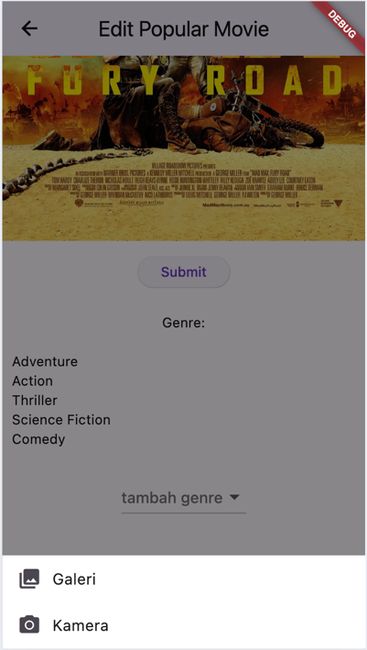
The _showPicker function
void _showPicker(context) {
showModalBottomSheet(
context: context,
builder: (BuildContext bc) {
return SafeArea(
child: Container(
color: Colors.white,
child: Wrap(
children: <Widget>[
ListTile(
tileColor: Colors.white,
leading: const Icon(Icons.photo_library),
title: const Text('Galeri'),
onTap: () {}),
ListTile(
leading: const Icon(Icons.photo_camera),
title: const Text('Kamera'),
onTap: () {},
),
],
),
),
);
});
}

Slide 8
_image object
Image from camera or gallery will be stored in _image object which have File type. If _image not null it will be displayed.
import 'dart:io';
import 'package:image_picker/image_picker.dart';
…
Uint8List? _imageBytes;
if(_imageBytes!=null)
Padding(
padding: const EdgeInsets.symmetric(vertical: 16.0),
child: Image.memory(_imageBytes!)),

Slide 9
_imgGaleri and _imgKamera
imgGaleri() async {
final picker = ImagePicker();
final image = await picker.pickImage(
source: ImageSource.gallery,
imageQuality: 50,
maxHeight: 600,
maxWidth: 600);
if (image != null) {
final bytes = await image.readAsBytes();
setState(() {
_imageBytes = bytes;
});
}
}
imgKamera() async {
final picker = ImagePicker();
final image =
await picker.pickImage(
source: ImageSource.camera,
imageQuality: 20);
if (image != null) {
final bytes = await image.readAsBytes();
setState(() {
_imageBytes = bytes;
});
}
}

Slide 10
Call _imgGaleri and _imgKamera
Call our previous two function in related listTile in _showPicker function . And in order two close the menu after click it, we use navigator pop.
onTap: () {
imgGaleri();
Navigator.of(context).pop();
onTap: () {
imgKamera();
Navigator.of(context).pop();

Slide 11
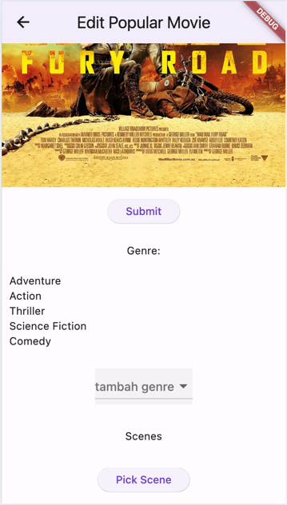

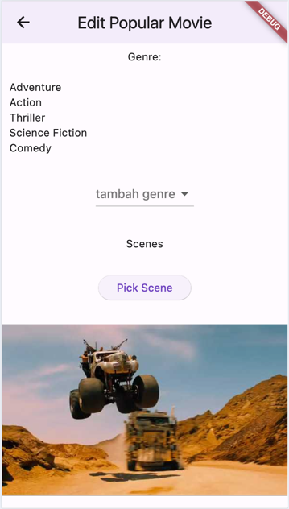
Gallery Result

Slide 12
Got MissingPluginException?
If you are running your app, stop it first then rerun again.
If you still get the exception, stop your app, then execute flutter clean and flutter pub get, then run again your app.

Slide 13
UPLOAD IMAGE
02

Slide 14
Upload Image
Next we will upload the picked image to the server. In the server, this image will be store in images/[movie_id] directory with unique filename taken from current timestamp.
For example if we edit movie with id 189, picking the poster image, and then upload, in the server will generate file, for example:
/images/189/20241123081512.jpg
Make images directory in your folder set the permission access to 777.
The uri will be sent in a base64Encode format.

Slide 15
uploadscene64.php
<?php
header("Access-Control-Allow-Origin: *");
header("Access-Control-Allow-Headers: Content-Type");
extract($_POST);
function saveBase64Image($base64Image, $movieId) {
$response = [
"result" => "error",
"message" => ""
];
// Decode the Base64 image string
$imageData = base64_decode($base64Image);
if ($imageData === false) {
$response["message"] = "Failed to decode Base64 image.";
return $response;
}
// The directory path
$directory = "images/" . htmlspecialchars($movieId);
// Create the directory if it doesn't exist
if (!is_dir($directory)) {
if (!mkdir($directory, 0777, true)) {
$response["message"] = "Failed to create directory.";
return $response;
}
}
// Generate a unique filename
$timestamp = time();
$filename = $timestamp . ".png"; // Adjust extension if needed
$filePath = $directory . "/" . $filename;
// Save the binary data to the file
if (file_put_contents($filePath, $imageData) === false) {
$response["message"] = "Failed to save the file.";
return $response;
}
$response["result"] = "success";
$response["message"] = "File successfully uploaded.";
$response["file_path"] = $filePath;
return $response;
}
$response = saveBase64Image($image, $movie_id);
echo json_encode($response);
?>
Prepare web service that accept base64 image and movie_id. Using file_put_content it will store base64 data into image file. You may need to create the images folder first and set it writable

Slide 16
Button upload
void uploadScene64() async {
String base64Image = base64Encode(_imageBytes!);
final response = await http.post(
Uri.parse("https://ubaya.cloud/flutter/[NRP]/uploadscene64.php"),
body: {
'movie_id': widget.movieID.toString(),
'image': base64Image,
},
);
if (response.statusCode == 200) {
Map json = jsonDecode(response.body);
if (json['result'] == 'success') {
if (!mounted) return;
ScaffoldMessenger.of(context)
.showSnackBar(SnackBar(content: Text('Sukses mengupload Scene')));
setState(() {
bacaData();
});
}
} else {
throw Exception('Failed to read API');
}
}
add a button that call previous function.
if(_imageBytes!=null)
Padding(
padding: const EdgeInsets.symmetric(vertical: 16.0),
child: ElevatedButton(child: const Text("Upload"),
onPressed: () => uploadScene64())),
check your images folder after uploading a scene

Slide 17
LIST SCENE
02

Slide 18
update detailmovie.php
..........
// Get image files from the directory
$imageDir = "images/" . htmlspecialchars($id);
$images = [];
if (is_dir($imageDir)) {
$files = scandir($imageDir);
foreach ($files as $file) {
if ($file !== "." && $file !== ".." && preg_match('/\.(jpg|jpeg|png|gif)$/i', $file)) {
$images[] = $imageDir . "/" . $file; // Add full file path
}
}
}
$r["scenes"] = $images;
.........

Slide 19
add listview
Update the popmovie class to get scenes array.
Add listview :
if(_pm != null)
Padding(
padding: const EdgeInsets.all(10),
child: ListView.builder(
shrinkWrap: true,
itemCount: _pm!.scenes!.length,
itemBuilder: (BuildContext ctxt, int index) {
return Image.network(
"https://ubaya.cloud/flutter/[NRP]/"+_pm?.scenes?[index],
height: 200, // Set a fixed height
width: double.infinity, // Set width to fill the screen width
fit: BoxFit.fitHeight
);
})),

Slide 20
EXERCISE
04

Slide 21
EXERCISE
Can you delete the uploaded scene?

Slide 22



